Slide 1
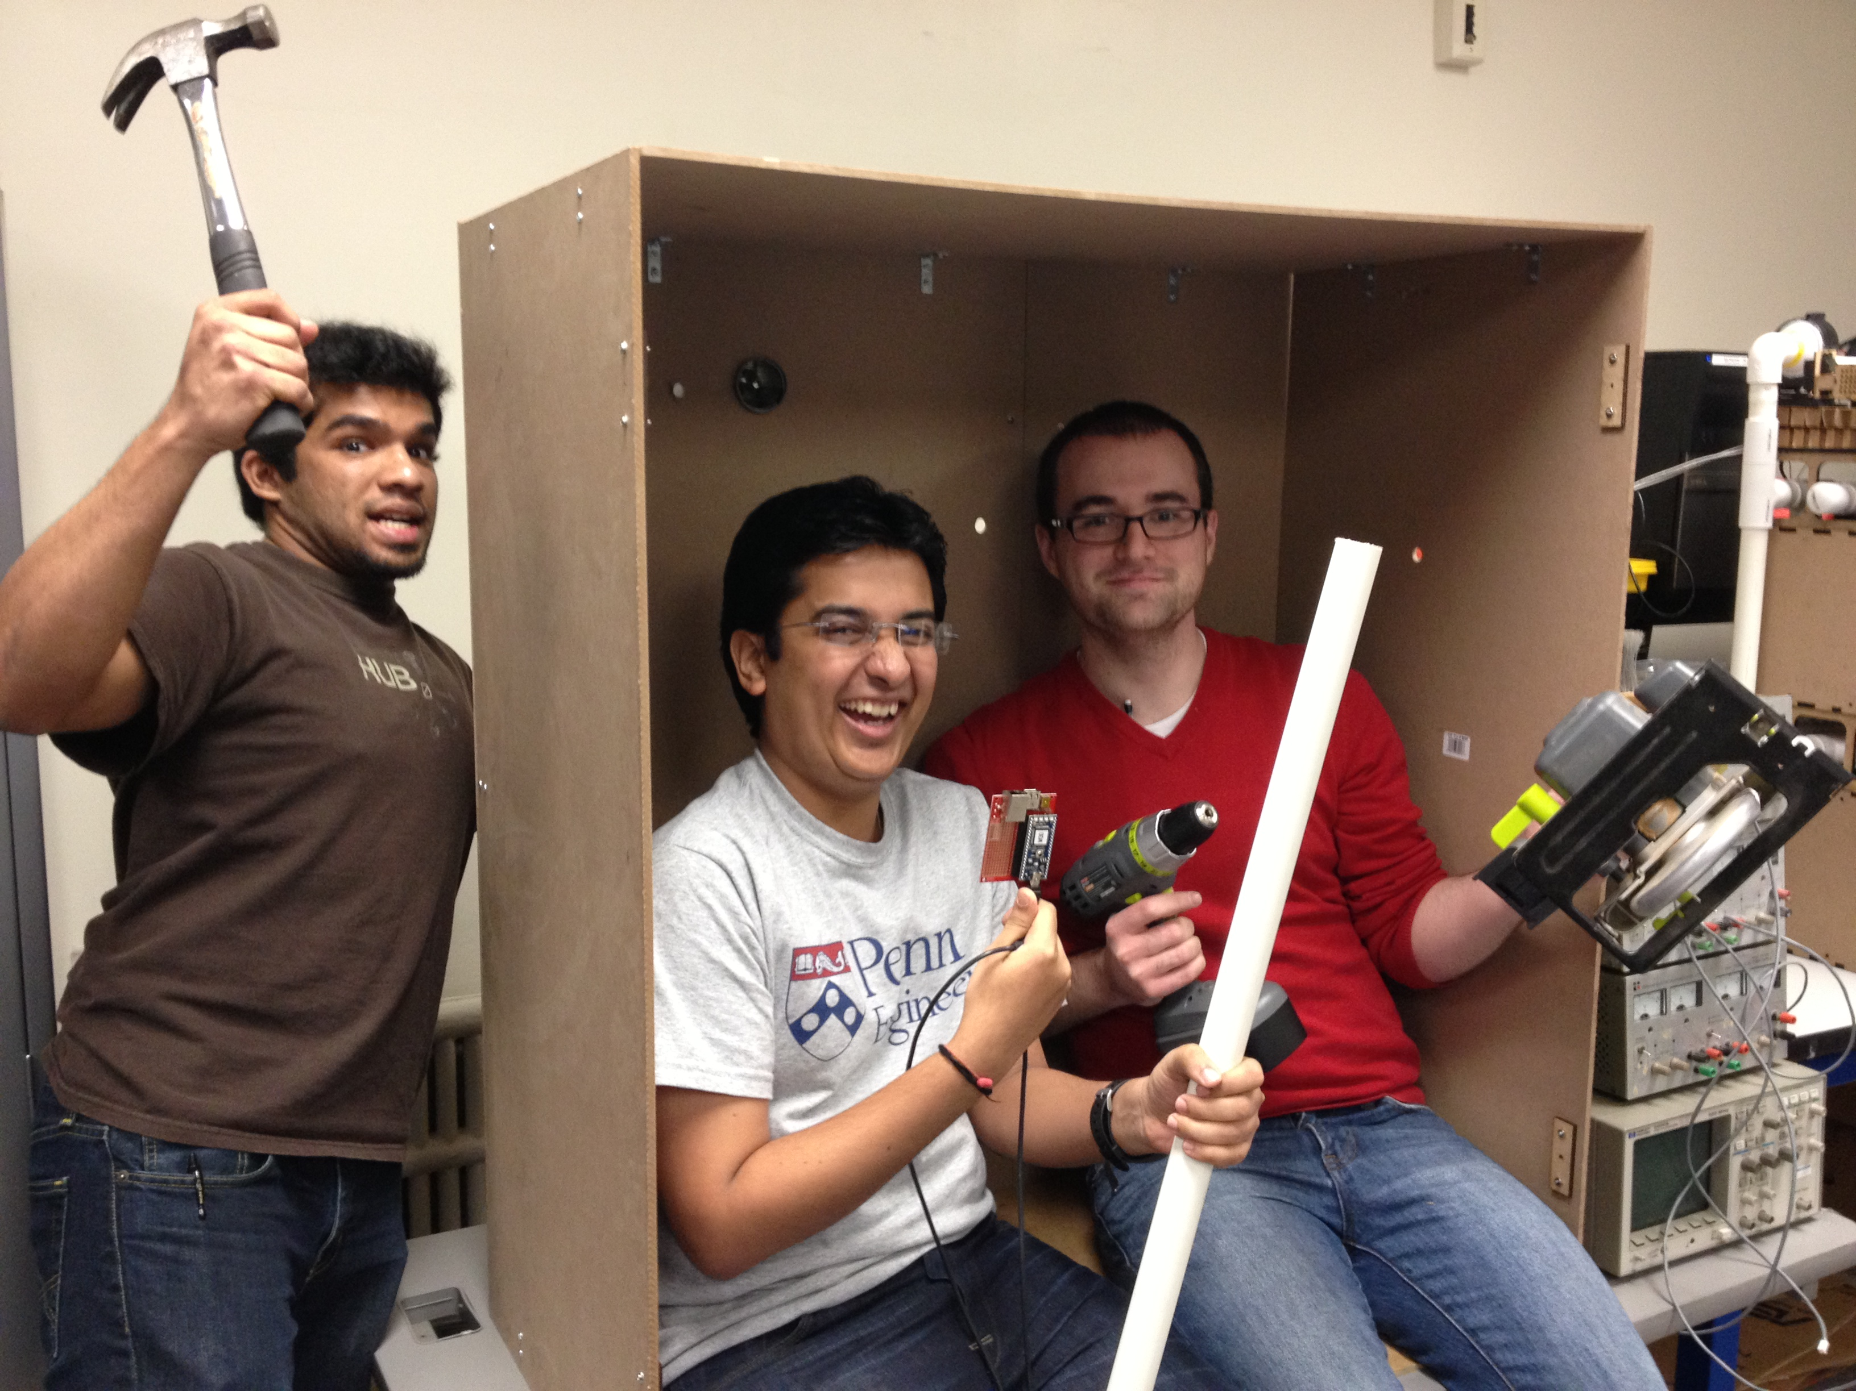
EnRoute2.0
-The HVAC test bed
Notes:
We are TEAM EnRoute2.0 and as Dr. Mangharam initially introduced our team to Madhur we are Two robo and Neel and the image that you now see on the screen is our ‘work in progress’ image. Welcome to EnRoute2.0

Slide 2
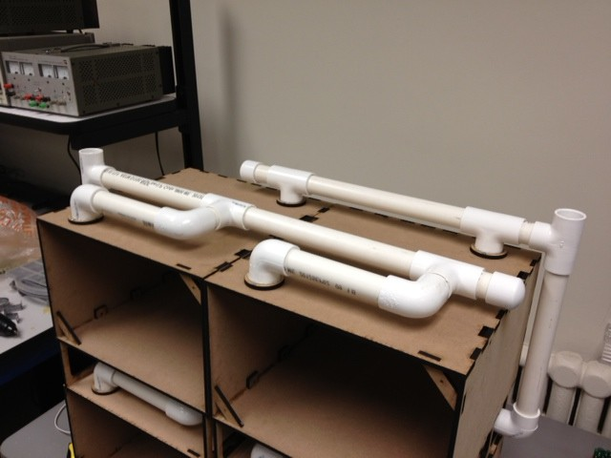
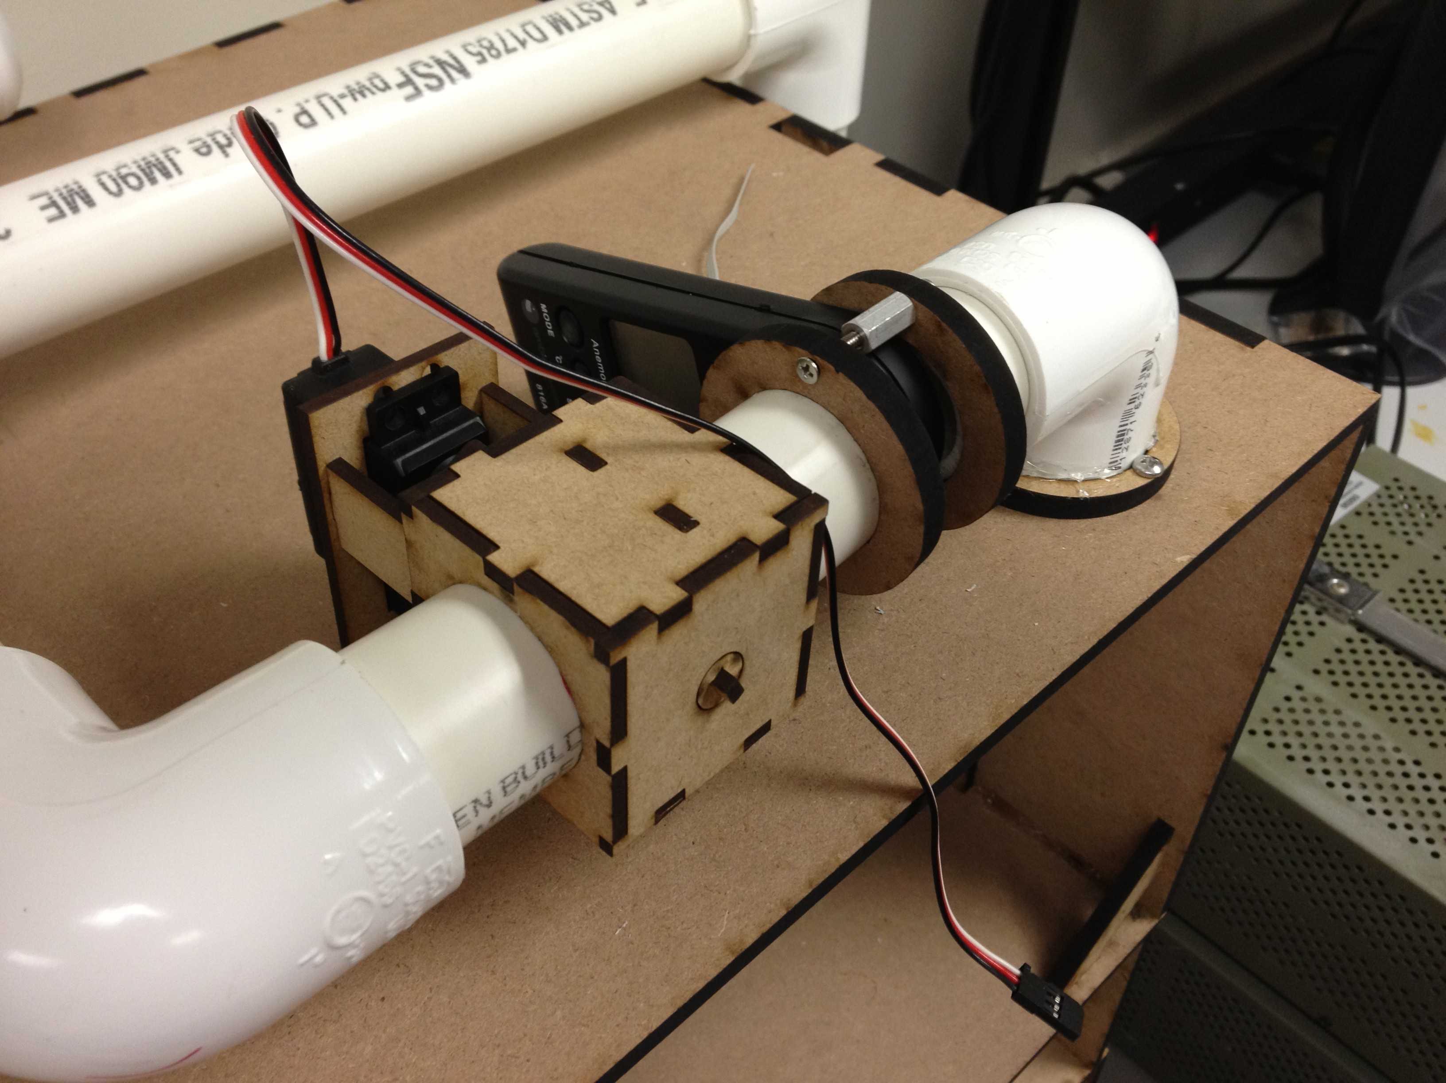
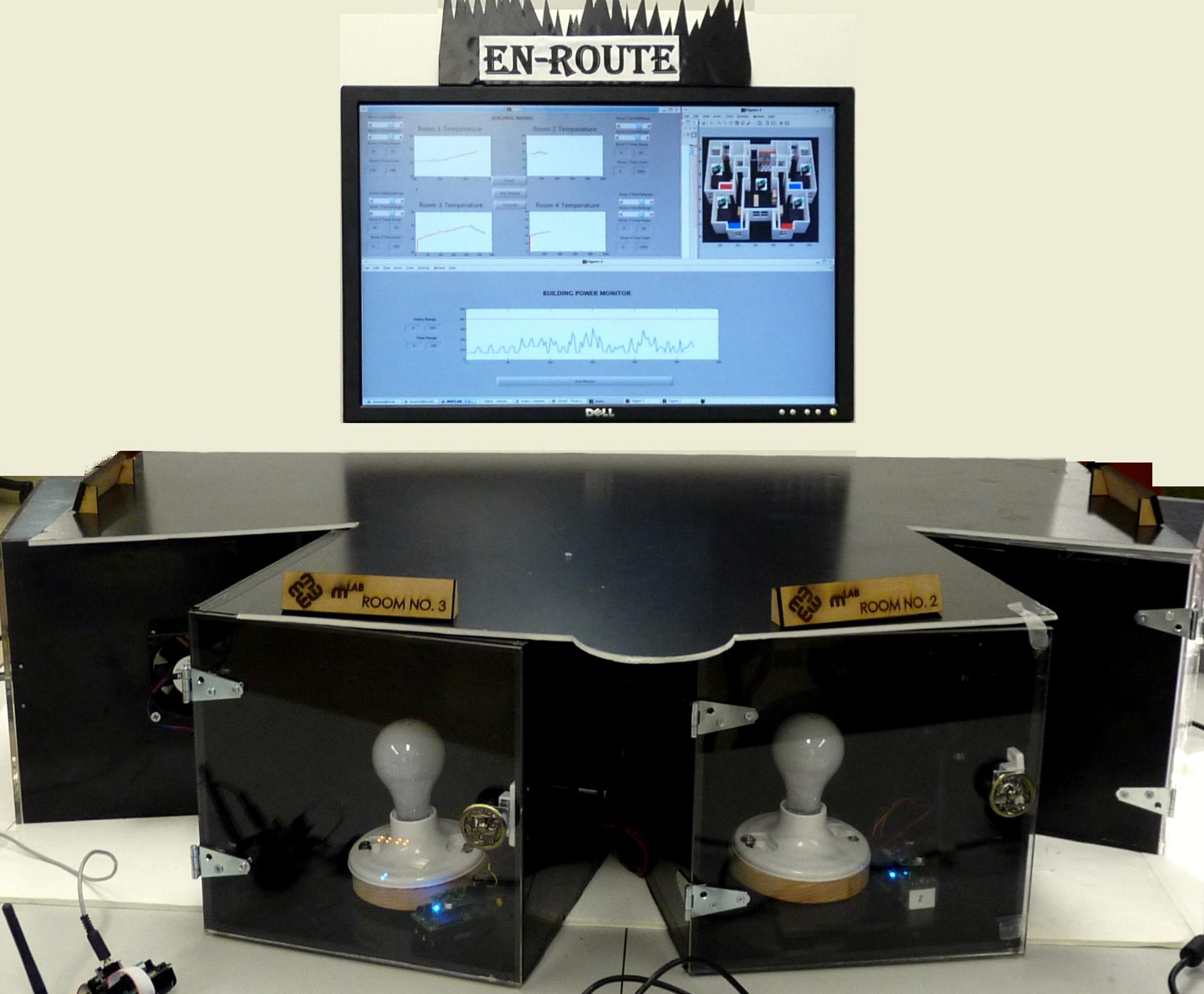
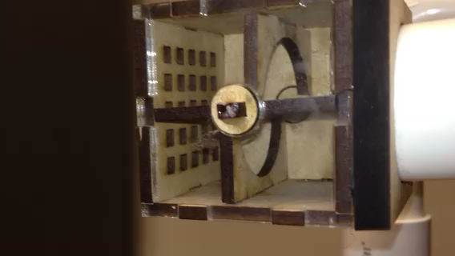
The Purpose
Notes:
EnRoute is the name of a series of HVAC test beds as an attempt to mimic the real world HVAC systems. The pictures that you see on the screen are from EnRoute1.0. This first version had no duct work or valve control. So we went ahead to design a new test bed, EnRoute2.0 which included duct work, valve position control and thus could mimic the real world scenarios more closely than before.

Slide 3
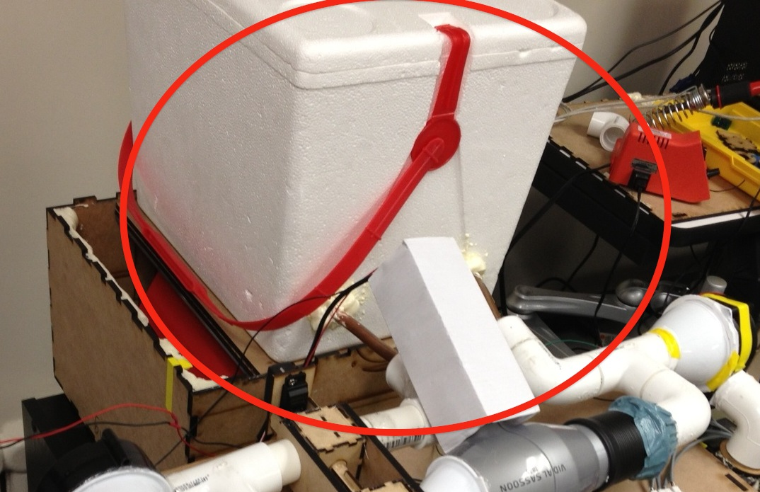
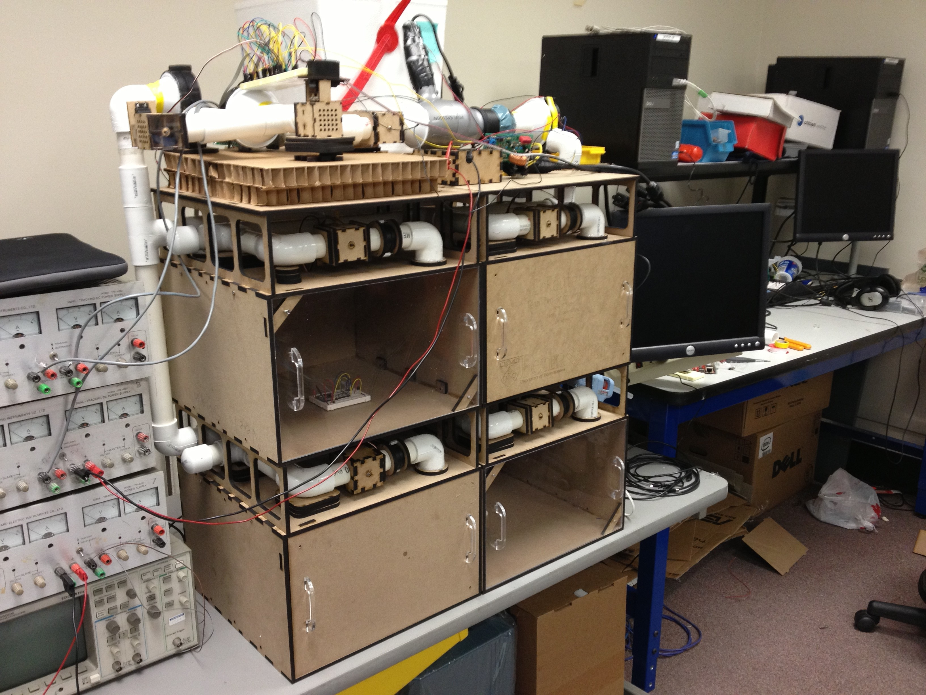
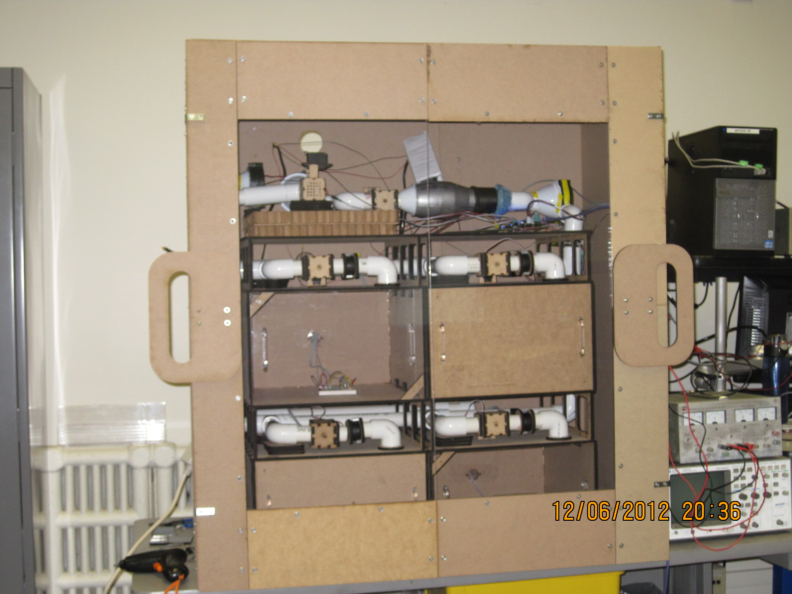
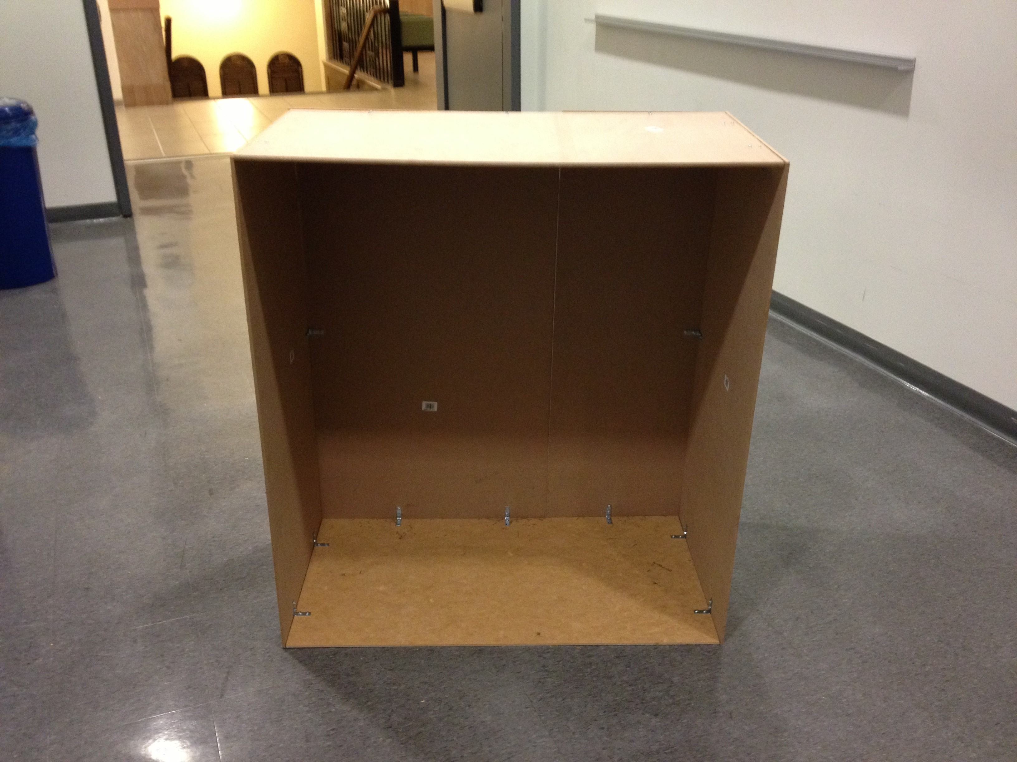
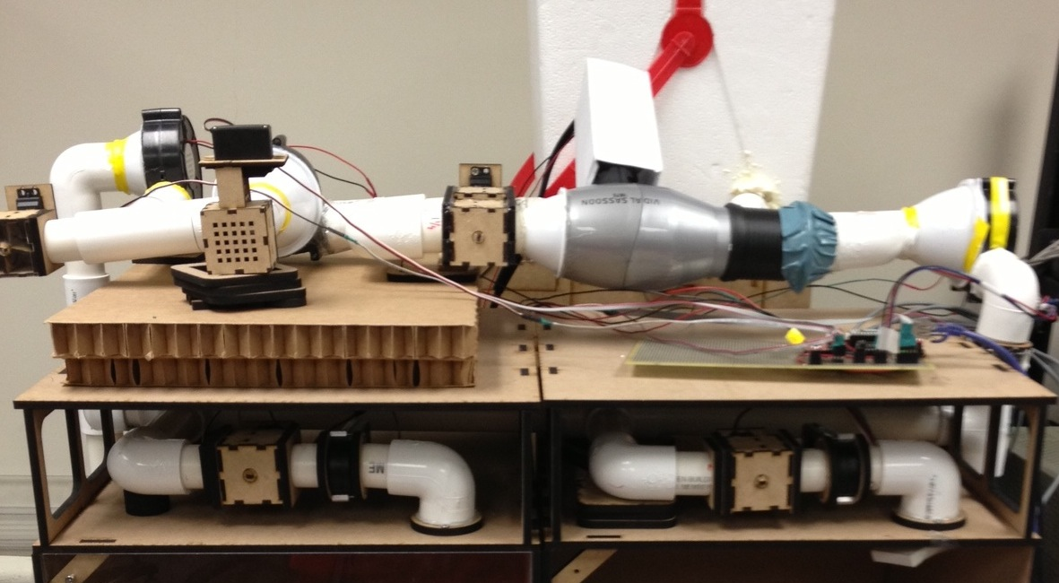
The Hardware
Notes:
Heater->Cooler->Picture without enclosure->Enclosure->Picture with Enclosure

Slide 4
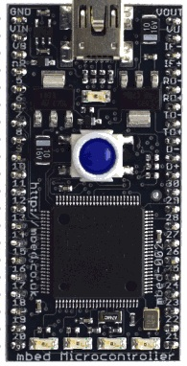
The Software
ZONE 1
ZONE 2
HVAC
MATLAB
Notes:
We have used the mBed development board and interfaced that with matlab. We can track changes in flow rate of the air passing through the valves as well as the temperature of each zone. The GUI also allows for manual control of servo valve positions to limit the flow of air into each zone. We can control our system using serial communication via the mBed as well as remotely using a static IP.

Slide 5
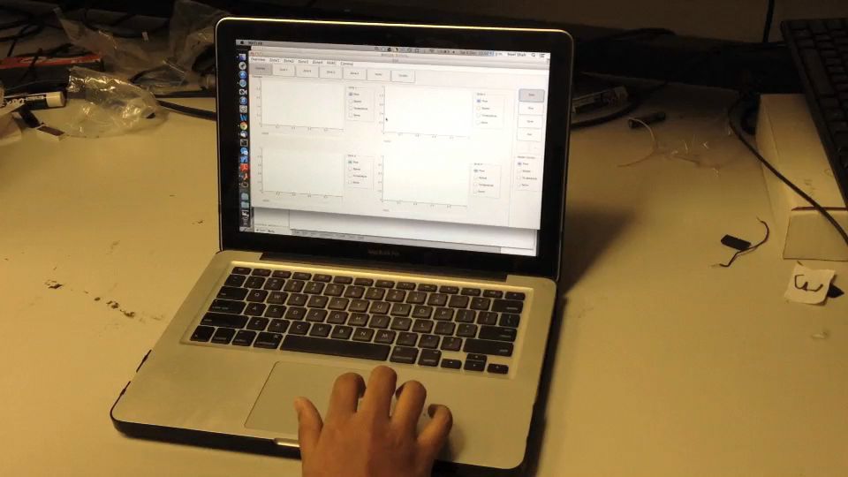
Control
Simulink Control
-Build model in Simulink with template
-Little to no programming required
-Lazy Scheduling
Manual Control
-Change Position of Servo Valves
-Change States of Blowers
-Heating v. Cooling

Slide 6
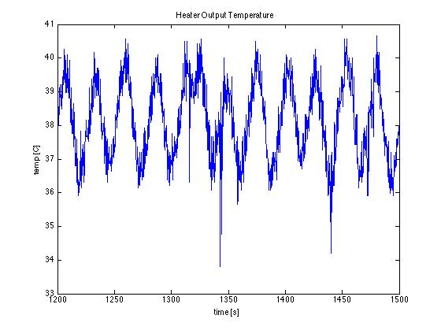
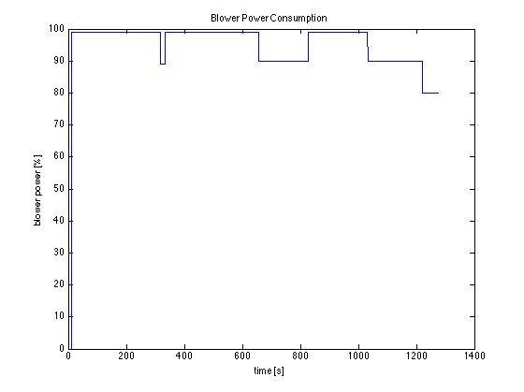
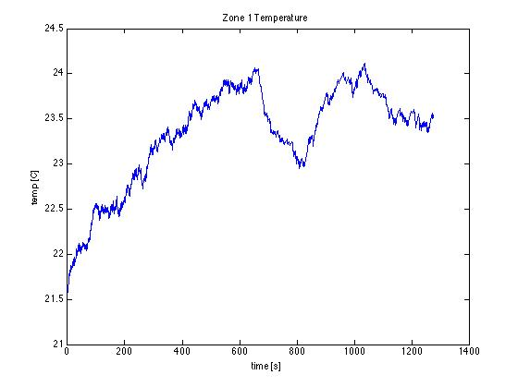
Simulations

